Slide 1
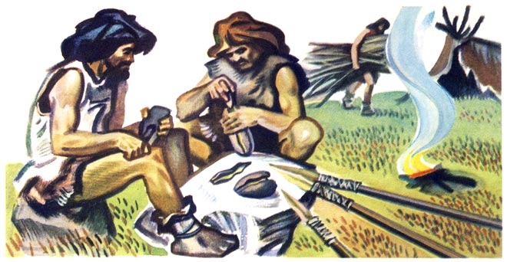
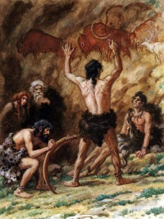
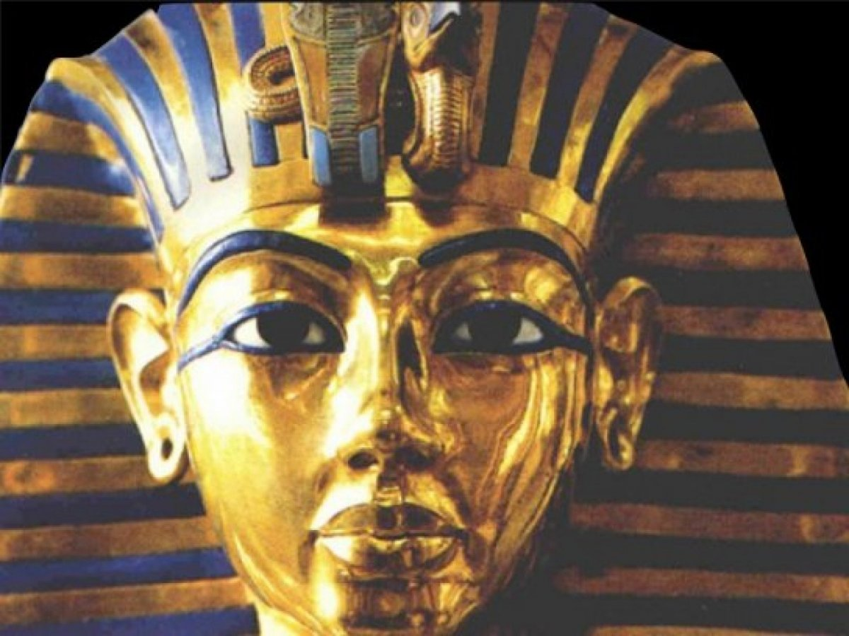
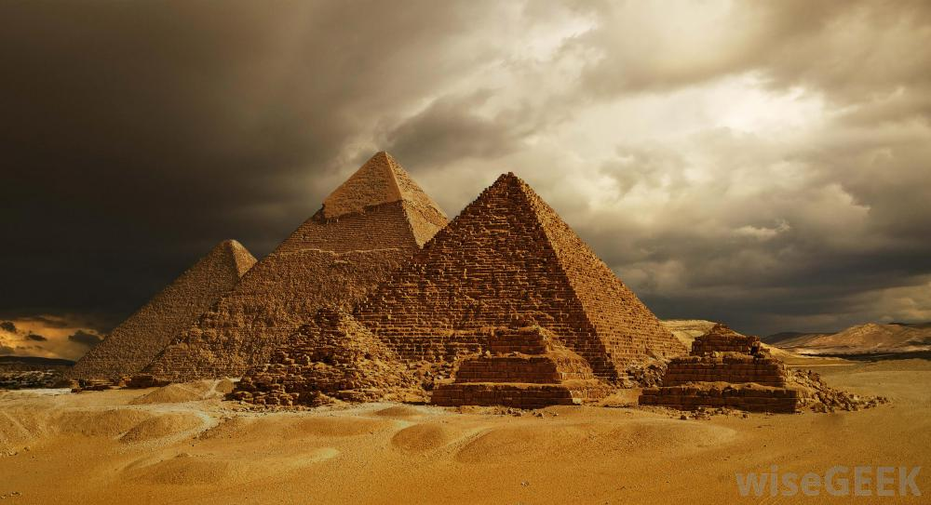
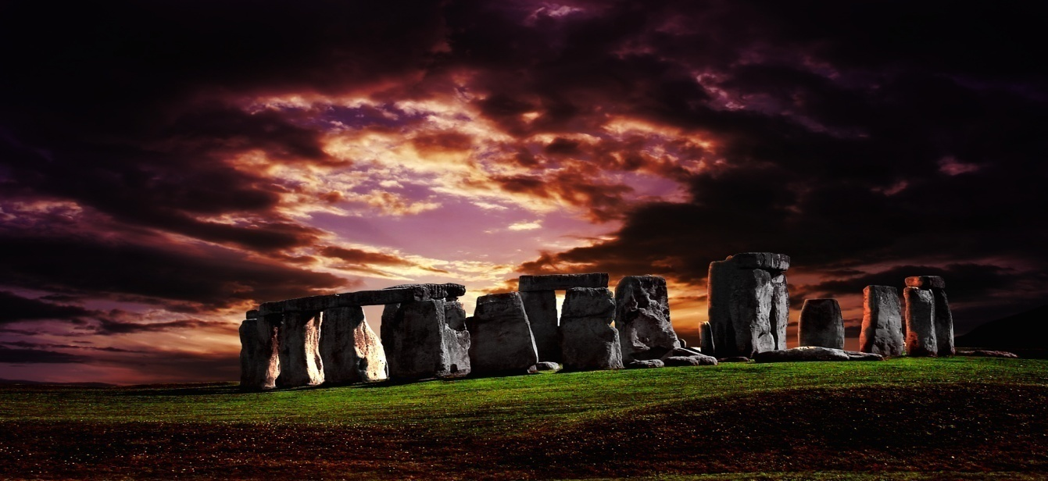
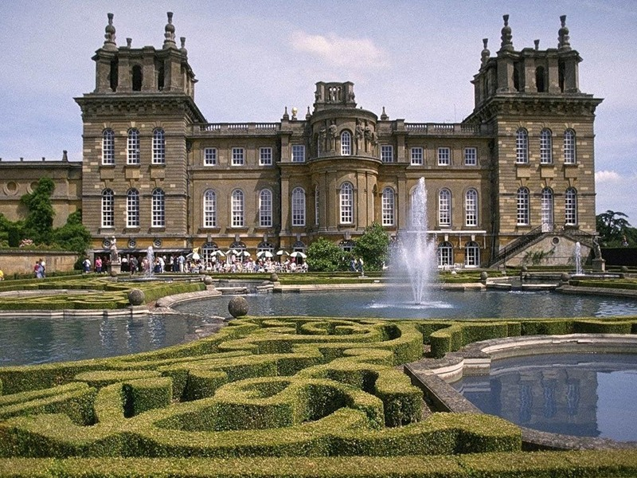

Slide 2
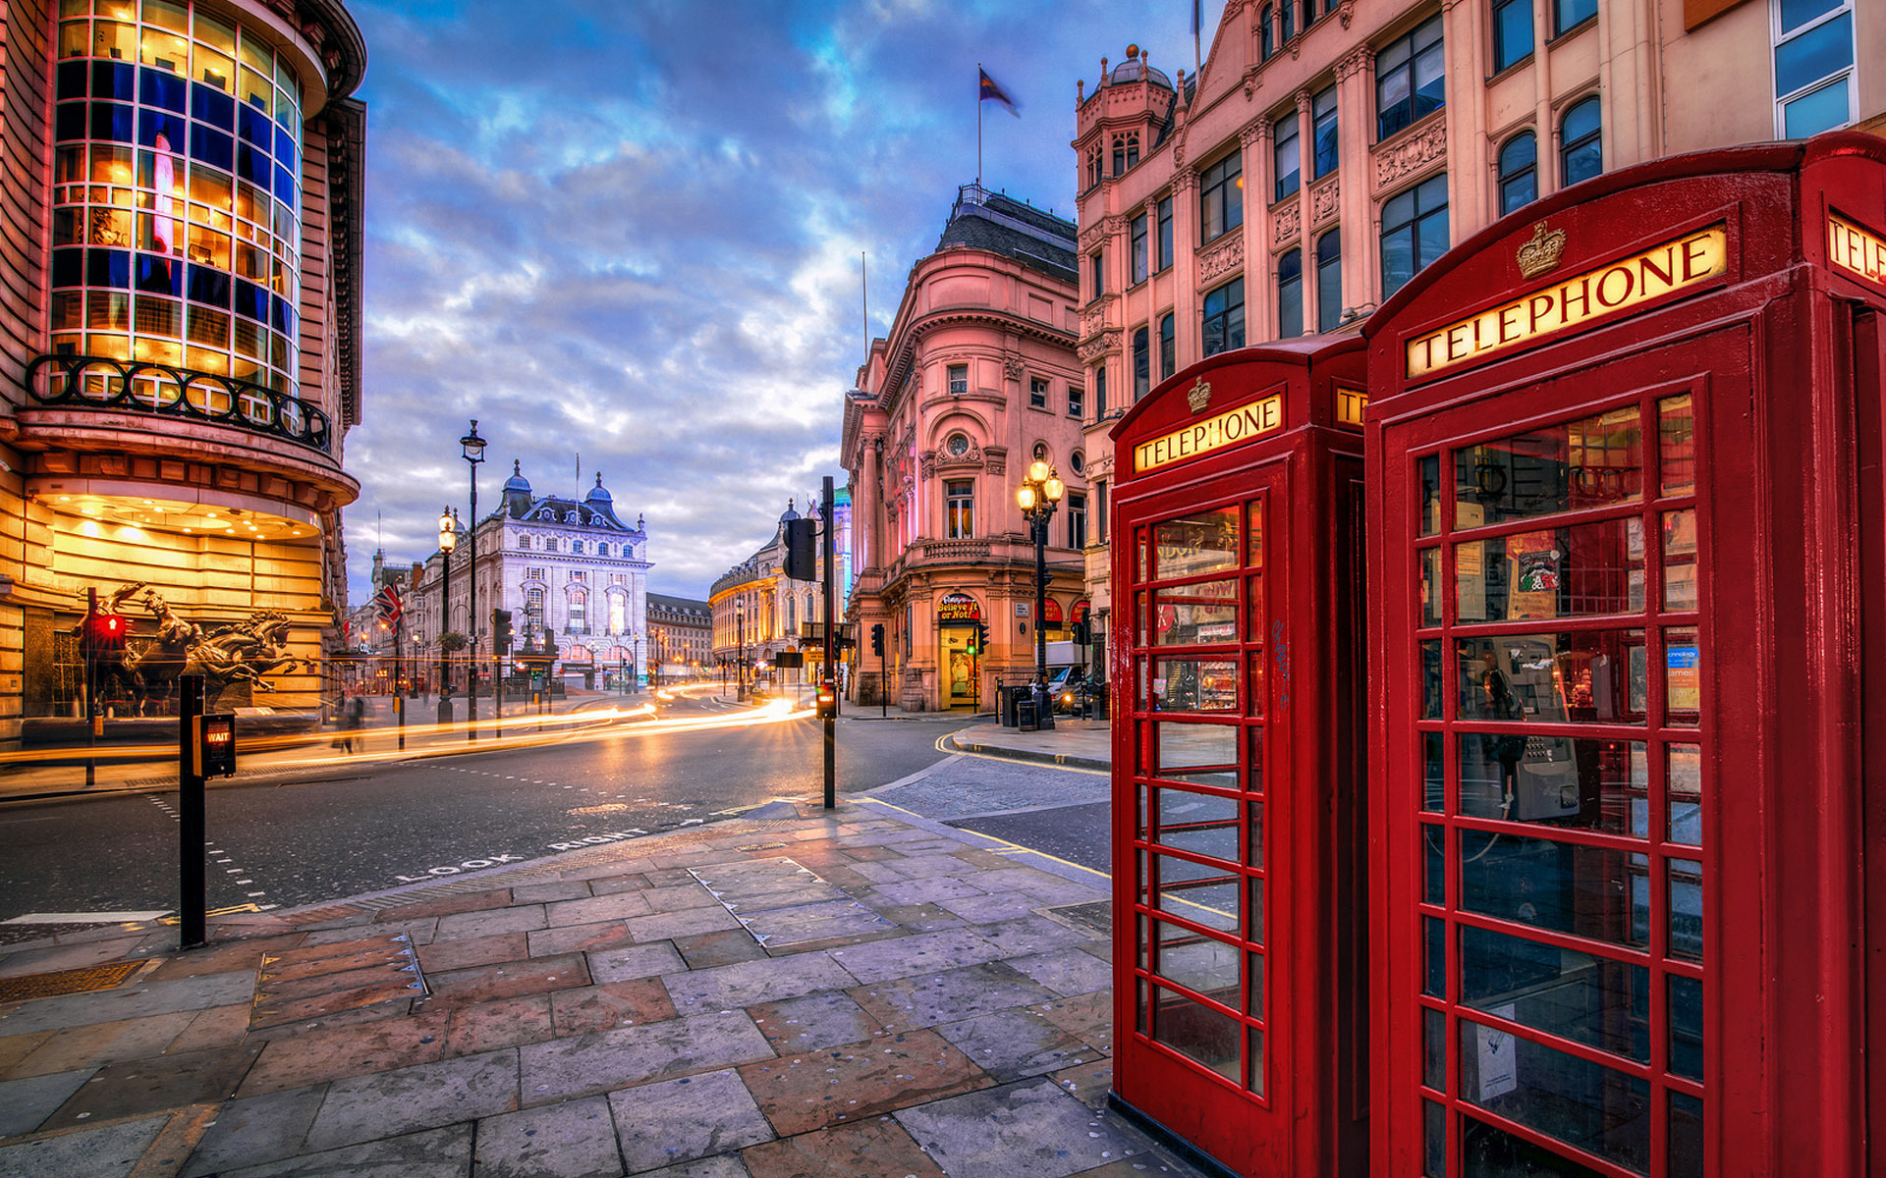
PHONETICS

Slide 3
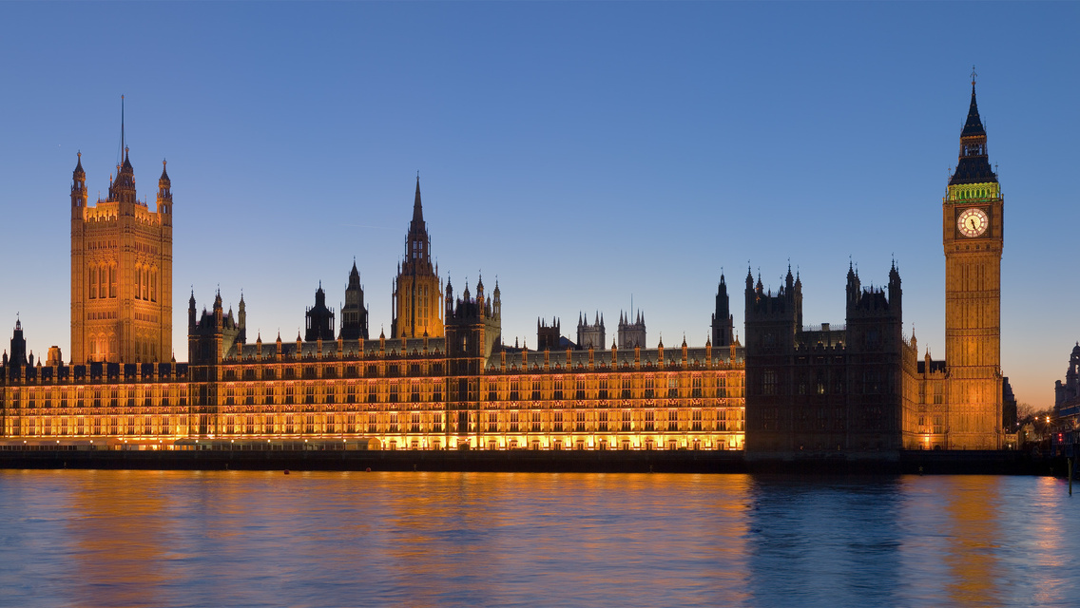
[ w ]
Why do you cry, Willy?
Why do you cry?
Why, Willy?
Why, Willy?
Why, Willy?
Why?
[ ð ]
Father, mother,
Sister, brother,
Hand in hand
With one another

Slide 4
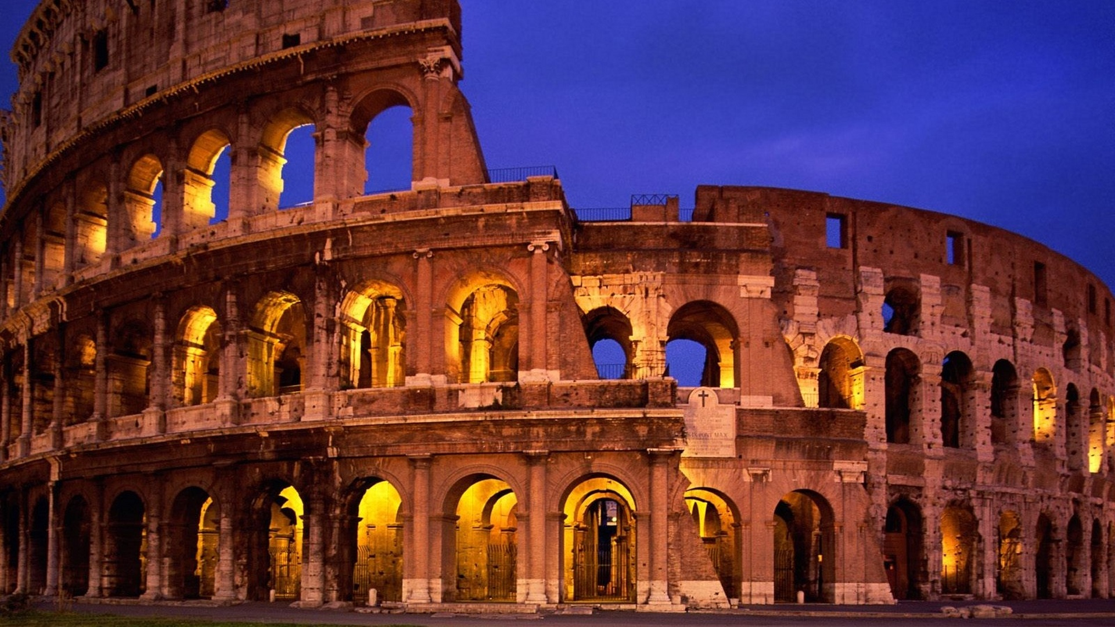
One fly flies, two flies fly. One girl cries, four girls cry.
I miss my Swiss Miss. My Swiss Miss misses me.
Roberta ran rings around the Roman ruins.

Slide 5
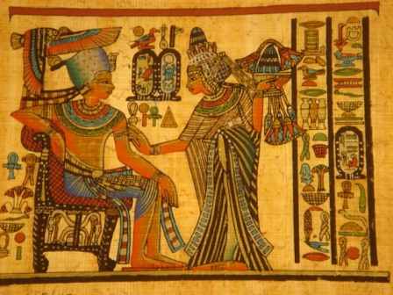
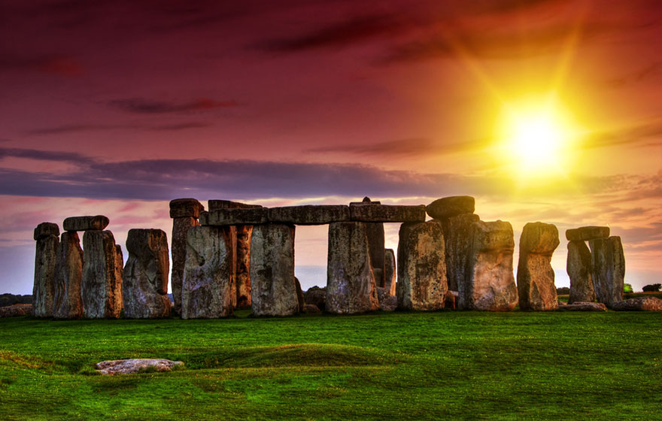
WONDERS OF THE ANCIENT WORLD

Slide 6
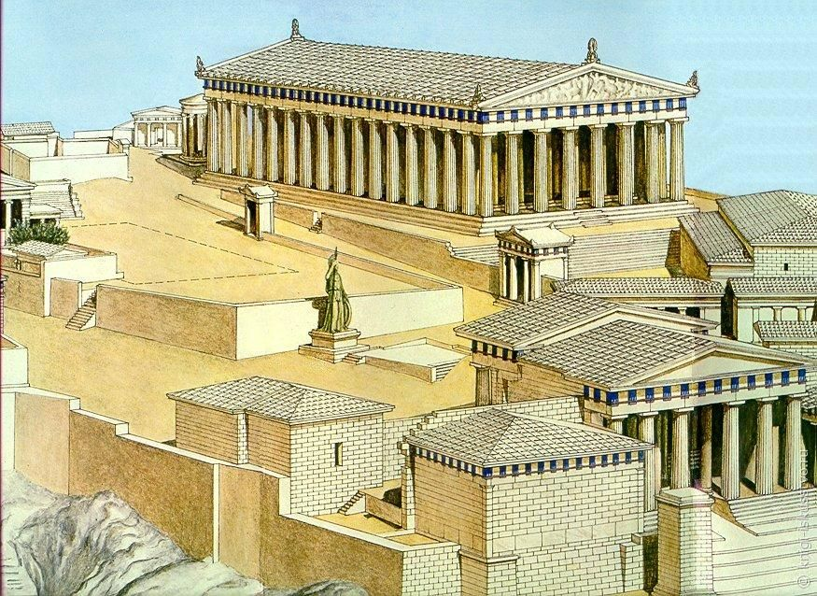
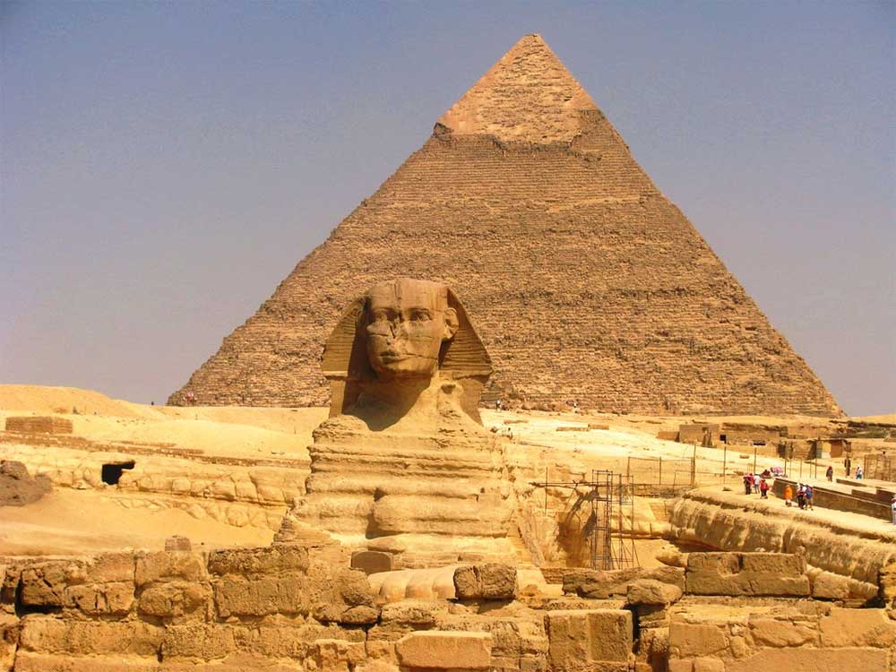
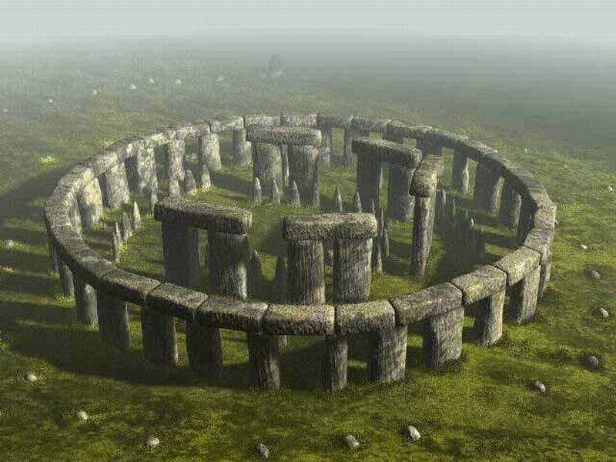
1
2
3

Slide 7
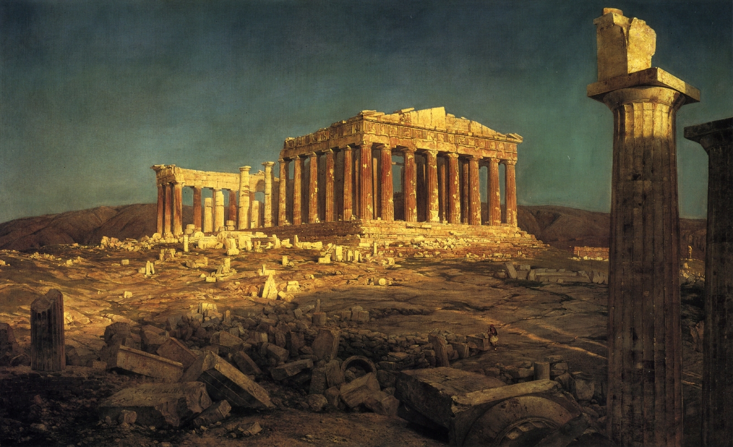
GAME
When did Stone Age people start to build Stonehenge?
Where were the enormous stones from?
How old was Tutankhamun when he died?
What were there in King's tomb?
What goddess was the Parthenon build for?
When was the Parthenon destroyed?

Slide 8
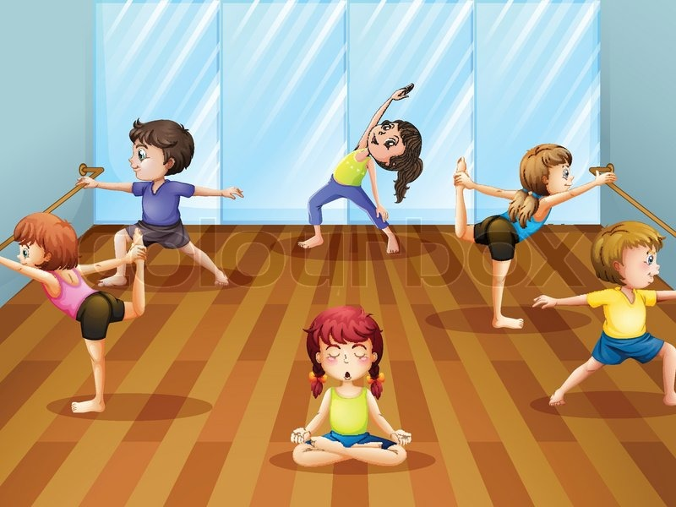
ФИЗКУЛЬТМИНУТКА

Slide 9
SPEAKING
What was Stonehenge?
Where were Queen Nefertiti and King Amenhotep from?
What was the capital of Ancient Greece?
Where were the first Olympic Games?

Slide 11
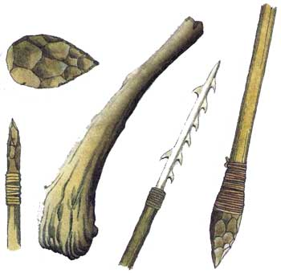
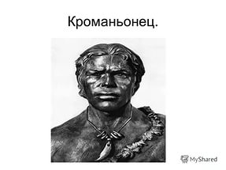
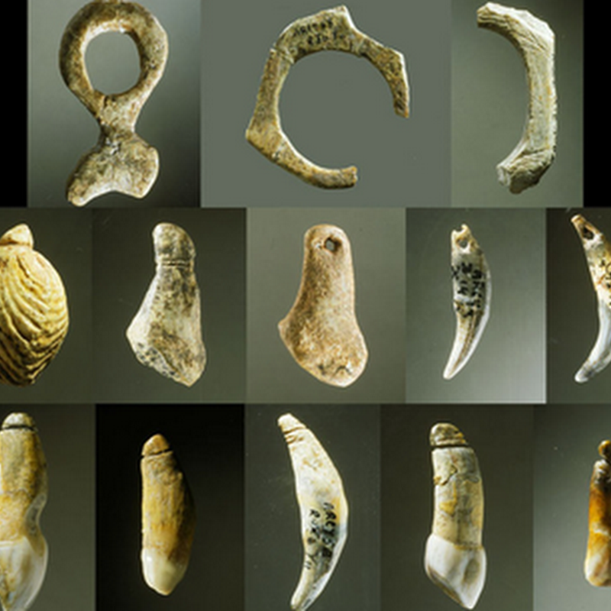
ANSWER THE QUESTION: WHAT DID CRO-MAGNONS USE BONES OF ANIMALS FOR?

